Slide 1


SAP S/4HANA Training
MASTER DATA GOVERNANCE (SAP MDG)
Neeraj Gupta
Session 28
SAP MDG – Consolidation & Mass Processing

Slide 2
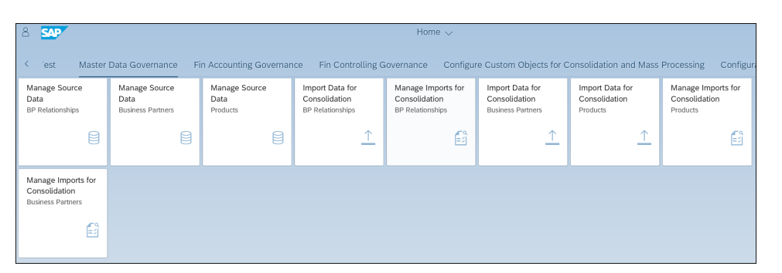
Import Data for Consolidation
28
SAP MDG – Consolidation and Mass Processing
SAP Fiori Apps to Perform and Manage Data Imports in Consolidation

Slide 3
Import Data for Consolidation
28
SAP MDG – Consolidation and Mass Processing
Consolidation Import Templates Delivered for Material and Business Partner Object Types

Slide 4
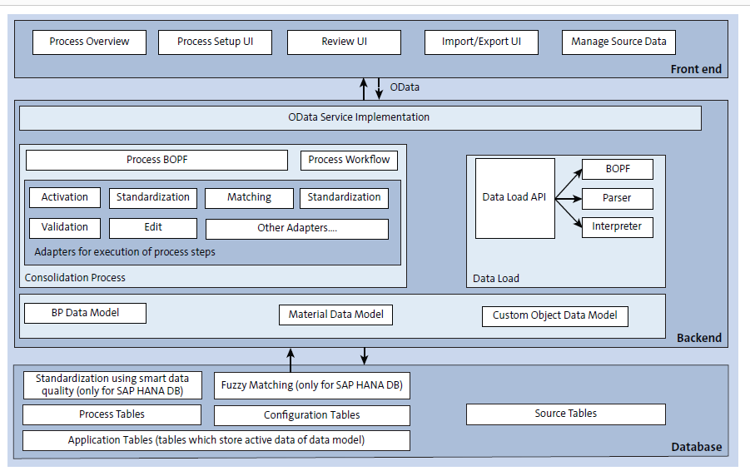
Architecture for Consolidation
28
SAP MDG – Consolidation and Mass Processing

Slide 5
FIORI APPs for Consolidation
28
SAP MDG – Consolidation and Mass Processing
Process is linked to business objects through the process template and URL parameters (otc) during runtime

Slide 6
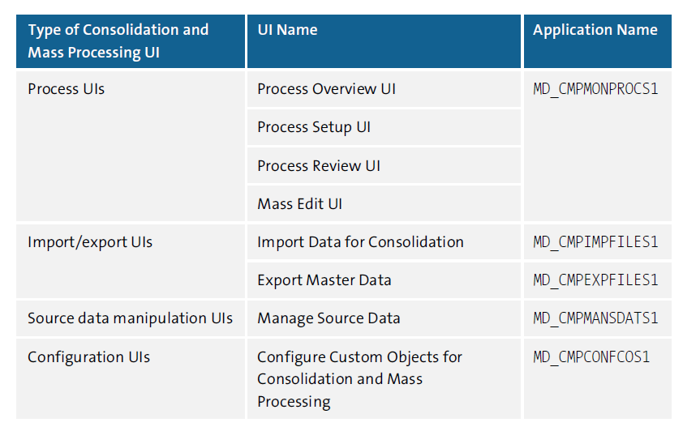
UIs Delivered by SAP for Consolidation and Mass Processing
28
SAP MDG – Consolidation and Mass Processing

Slide 7
Frontend architecture principle
28
SAP MDG – Consolidation and Mass Processing
Terms:
hash-based navigation
SAPUI5 navigation services
pattern
Route
intent-based navigation
semantic objects
Action
Semantic object parameters
Internationalization
resource bundle files

Slide 8
Master Data Semantic Object
28
SAP MDG – Consolidation and Mass Processing

Slide 9
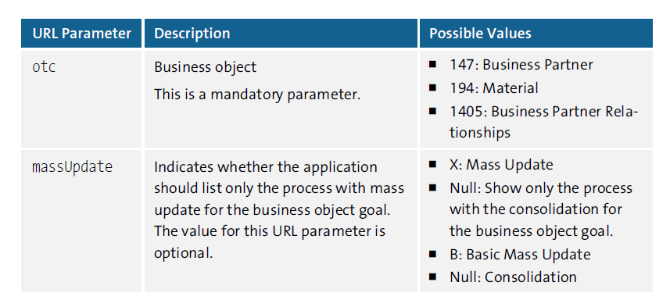
URL Parameters for Process Overview UIs
28
SAP MDG – Consolidation and Mass Processing
Process-related UIs are delivered as SAPUI5 XML views under the application with namespace mdm.cmd.cmpmonprocs1. SAPUI5 view is MDCOverview for the process overview UI

Slide 10
URL Parameters for Process Overview UIs
28
SAP MDG – Consolidation and Mass Processing

Slide 11
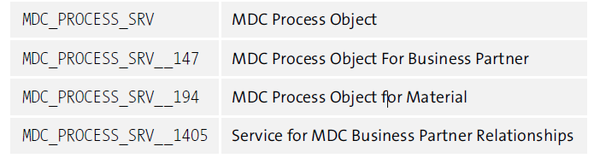
Odata Services for Business Objects
28
SAP MDG – Consolidation and Mass Processing

Slide 12
Process Setup User Interface
28
SAP MDG – Consolidation and Mass Processing
A process will be created by creating an OData entity of type ROOTSet
SAPUI5 view MDCProcDisplay

Slide 13
Process Display User Interface
28
SAP MDG – Consolidation and Mass Processing
SAPUI5 XML view - MDCProcDisplay

Slide 14
Match Review & Best record Calculation User Interface
28
SAP MDG – Consolidation and Mass Processing

Slide 15
Elements of Backend Architecture
28
SAP MDG – Consolidation and Mass Processing
OData Services 2.0
SAP Gateway
SAP Gateway projects
MDC_PROCESS
MDC_IMPORT
MDC_EXPORT
Business Object Processing Framework (BOPF)
BOPF Business Object: MDC_PROCESS
ROOT - MDC_S_PROCESS
SOURCE - MDC_S_PROCESS_SOURCE
STEP - MDC_S_PROCESS_STEP
BOPF Business Object: I_MASTERDATAIMPORTTP
Workflows
workflow template WS54500001 and BOR object BUS2240
Adapter Classes
Adapter classes - implements interface IF_MDC_ADAPTER (first register the class and assign it to a business object type)
Data model classes (transaction handling for business object data)

Slide 16
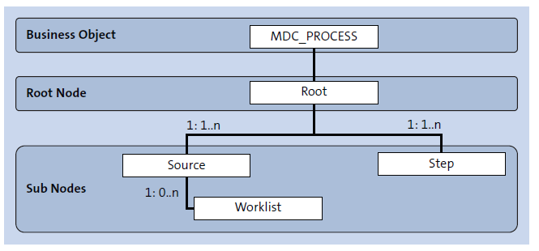
Business Object Model for MDC_PROCESS Object
28
SAP MDG – Consolidation and Mass Processing

Slide 17
Workflow Object Standard workflow template WS54500001
28
SAP MDG – Consolidation and Mass Processing

Slide 18
Adapter Classes
28
SAP MDG – Consolidation and Mass Processing

Slide 19

End of Session 28

Slide 20

Questions

Slide 21

Neeraj Gupta

Slide 22


We’re committed to empower you to be
Most Desirable Resource
through powerful training solutions.
We build the workforce of the future.
250+
Corporate Clients
30,000+
Learners Trained
25000+
Learners Placed
FREE WEBINARS
Sign up for free webinars with industry experts every fortnight!
Enroll Now!
Contact us today!
https://anubhavtrainings.com/

Slide 23




More from AnubhavTrainings.com

